Slide 1
Climate Change Analysis
Travis Marchok, Adam Whiteside, Eli Aaron, Chylle Gamino

Slide 2
Background
Climate change is an issue that will affect all of us
Statistics exist, but many still uninformed about consequences
Goal:
Transform raw data on climate to a useful tool to predict future trends
Provide future solution recommendations to slow effects

Slide 3
Agenda
01
02
03
Cluster analysis of greenhouse gases
CO2 contributing factors
Temperature vs. emissions
04
05
Temperature vs. year
Sea level analysis
Which greenhouse gas(es) is/are most harmful?
Analyze which factors correlate with high CO2 emissions
How have emissions affected U.S. avg. temperature?
Analyze U.S. temperature trends by year
How has global temperature affected sea level each year?

Slide 4
01
Cluster analysis of greenhouse gases

Slide 5
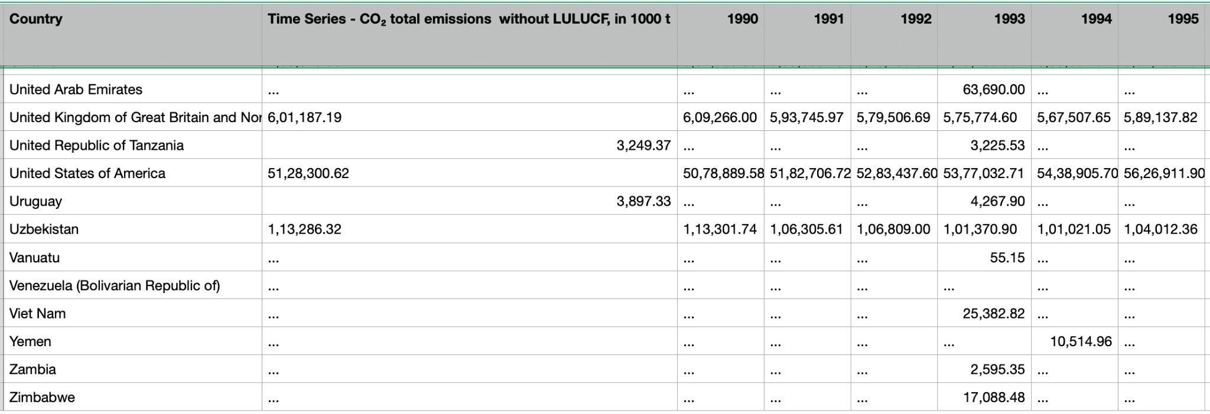
One of the Original emissions data set
Show cluster results

Slide 6
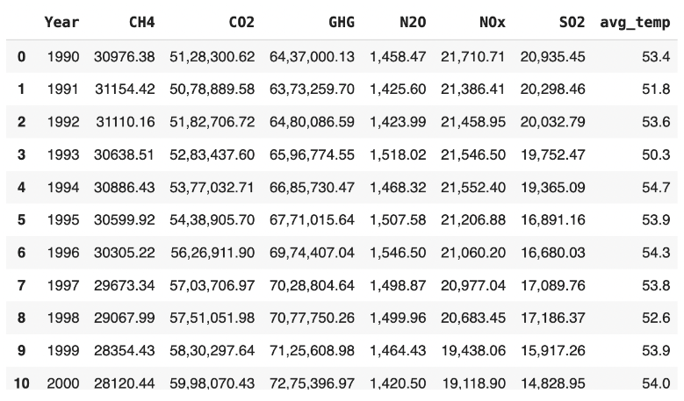
Cleaned data table after filtering, reshaping,and joining

Slide 7
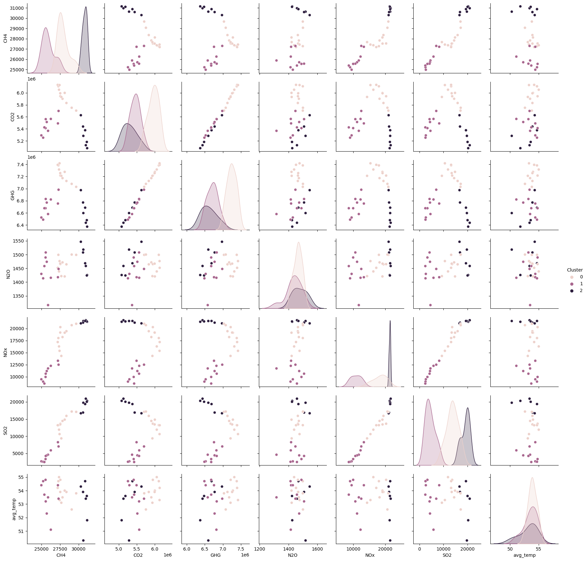
Results from clustering biplot

Slide 8
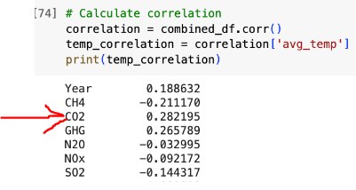
Correlation Evaluation
Co2 has the highest correlation

Slide 9
Conclusion from Emissions data
CO2 has the highest correlation to temperature increase

Slide 10
02
CO2 Emissions Contributing Factors

Slide 11
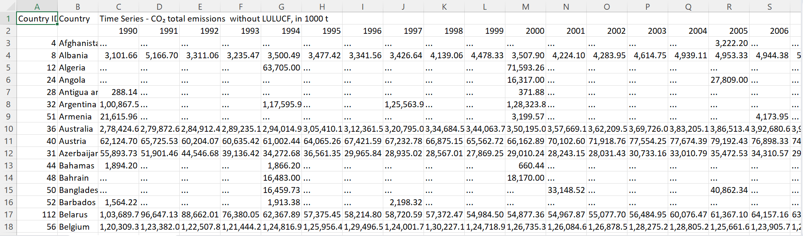
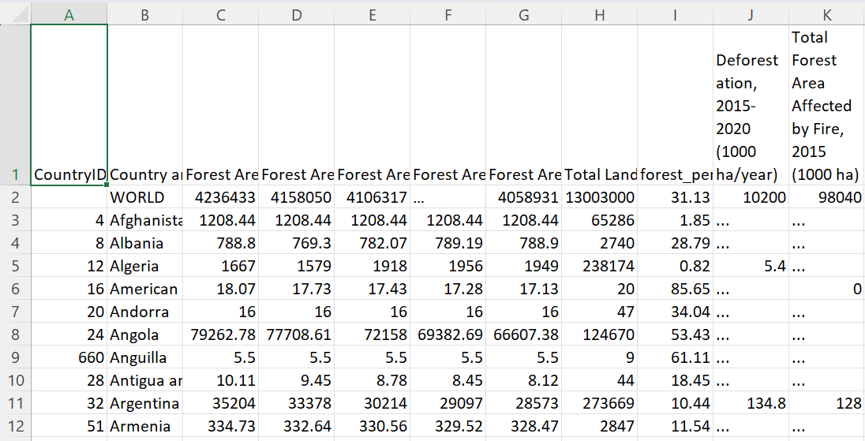
Original datasets

Slide 12
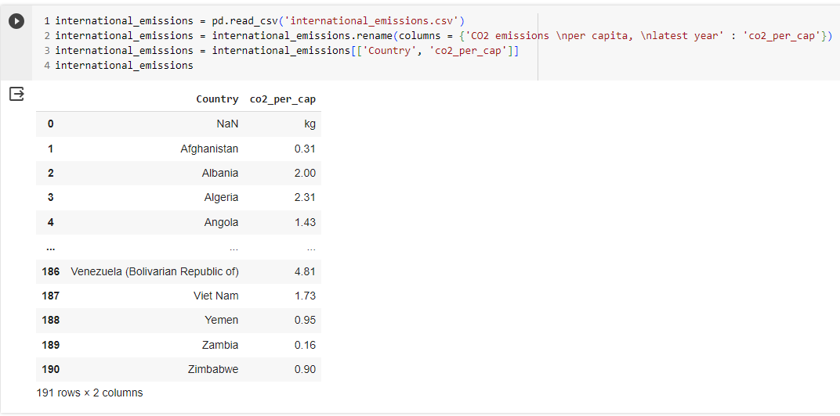
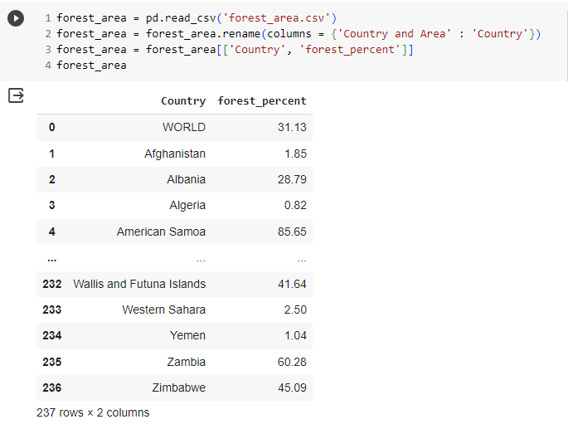
Cleaned datasets

Slide 13
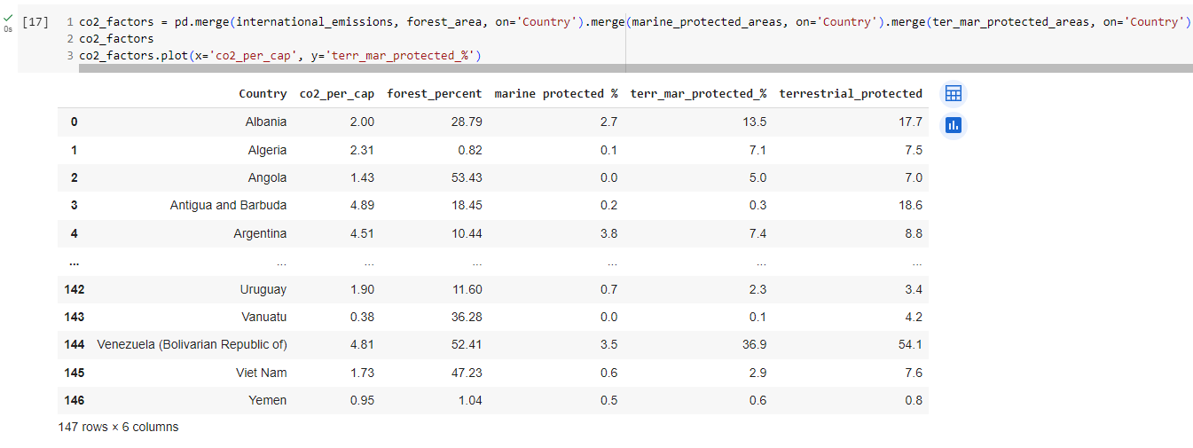
Integrated dataset

Slide 14
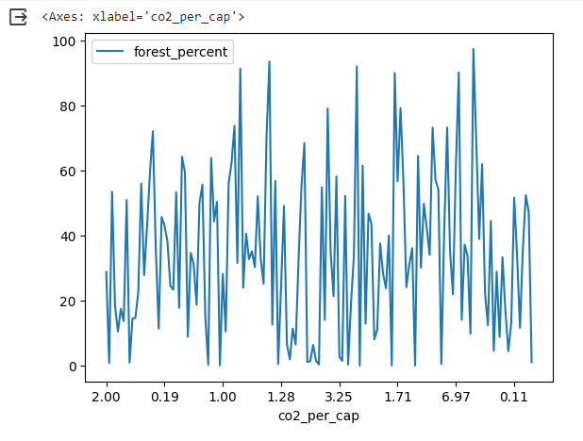
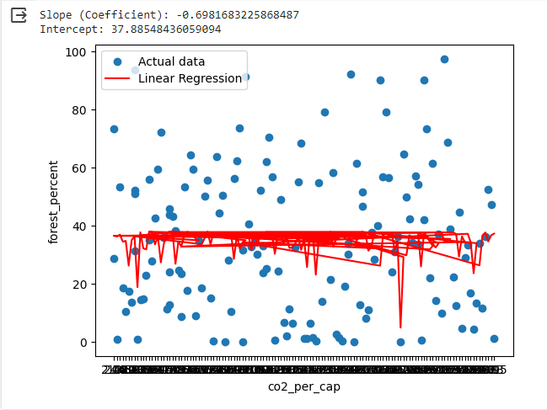
Correlations & key findings
Faced challenges finding correlations between any feature and CO2 emissions
Concluded that other factors impact CO2 emissions more than these
Still got valuable experience integrating datasets and attempting to train models

Slide 15
03
Evaluating correlation between CO2 emissions & U.S. temperature

Slide 16
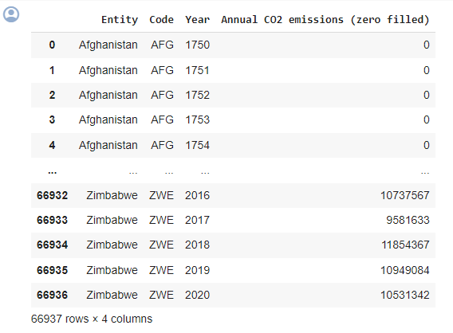
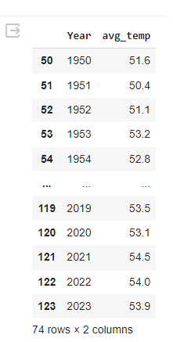
Original Datasets

Slide 17
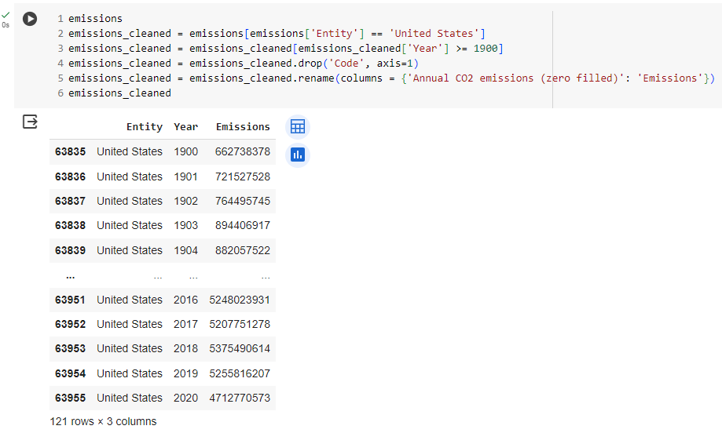
Data cleaning

Slide 18
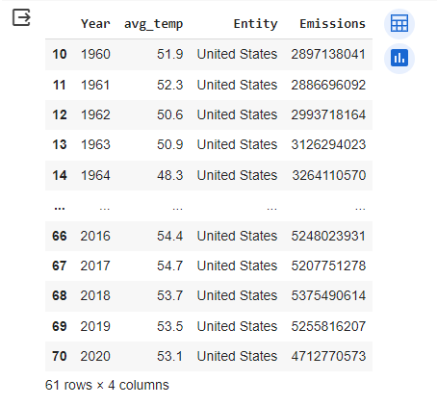
Integrated Dataset

Slide 19
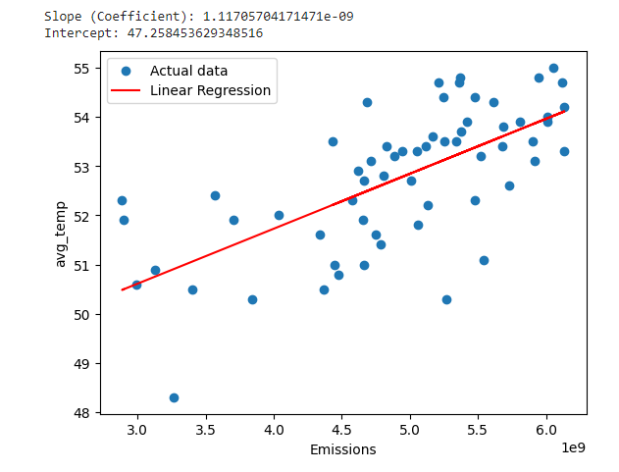
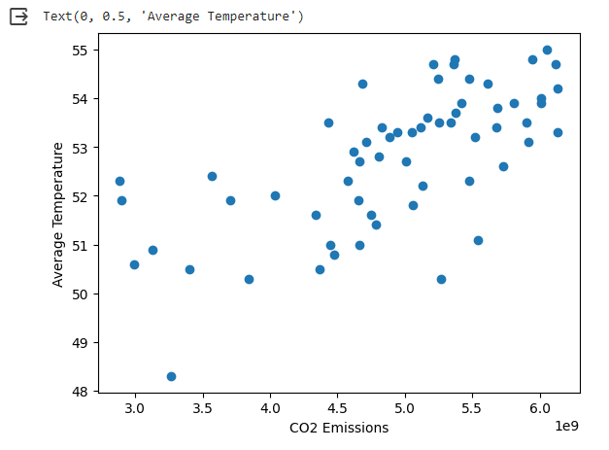
CO2 emissions correlated with average U.S. temperature

Slide 20
04
Analyzing correlation between temperature and year

Slide 21
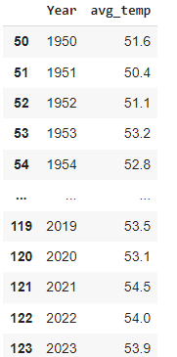
Temperature Dataset (no integration required)

Slide 22
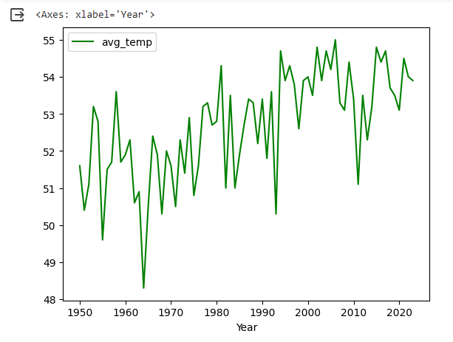
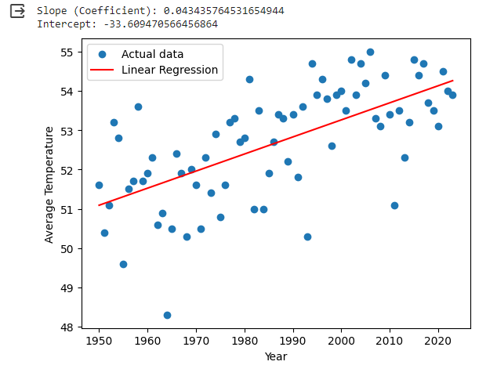

Slide 23
Conclusions from temperature and year
With y int = -33.609470566456864 and
slope = 0.043435764531654944
In 2100, the average temperature will be 57.6
This statistic will be used in the next part

Slide 24
Future temperature predictions & conequences

Slide 25
05
Sea level analysis

Slide 26
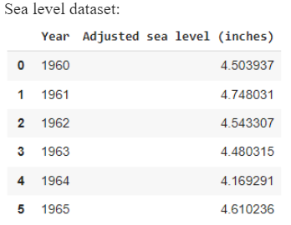
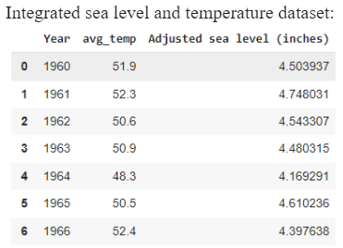
Integrating Sea Level and Temperature
+
=

Slide 27
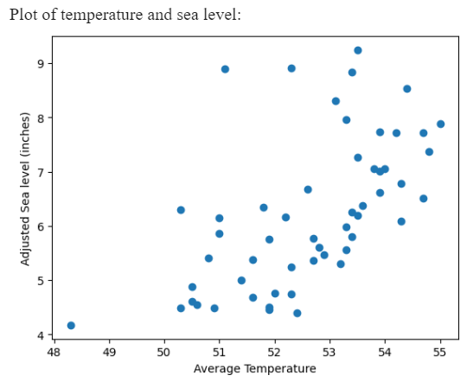
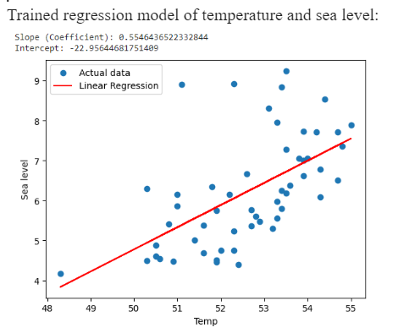
Sea level based on temperature scatter plots

Slide 28

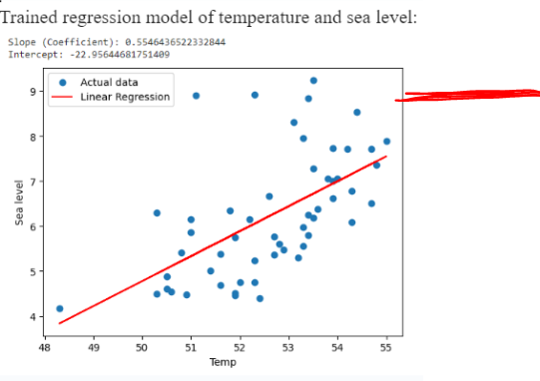
Overall Conclusion
If the temperature is 57.6 in 2100(gathered earlier), with our slope and intercept from the linear regression, the sea level will consistently be 9 meters, which would start to flood and destroy our coastal cities.
CO2 and other gas emissions need to be reduced
9 meters

